Slide 1








SNEAKERS & APPAREL BUSINESS POS SYSTEM
By: JB Anthony Bugsocan
Instructor: Engr. Julian Semblante

Slide 2


The JB SNEAKERS & APPAREL POS System is a console-based Point of Sale and Inventory Management application developed in C#.
It aims to help small retail stores efficiently manage their inventory, sales, and stock updates without needing expensive commercial POS software.

Slide 3
The system provides an interactive console interface with arrow-key navigation for smooth user experience. It allows authorized admins to add, edit, delete, and search products, handle categories dynamically, generate sales invoices, and automatically record inventory receipts. Each transaction and stock adjustment is logged with timestamps for accountability.

Slide 4
This project emphasizes reliability, accuracy, and automation for real-world store management needs, all within a simple text-based environment.

Slide 5

PROJECT OBJECTIVES:
FUNCTIONAL OBJECTIVES
  To create a fully functional console-based POS and Inventory Management System in C#.
  To implement an arrow-key-controlled user interface for intuitive navigation.
  To allow administrators to perform CRUD operations on products, customers, and suppliers.
  To generate printable Sales Invoices and Inventory Receipts automatically.
  To support dynamic category management through file-based data handling.

Slide 6
PROJECT OBJECTIVES:
PERFORMANCE OBJECTIVES
  Ensure data persistence through text file handling.
  Maintain accurate tracking of all inventory changes with receipt generation.
  Provide fast and clear menu navigation using keyboard controls.

Slide 7



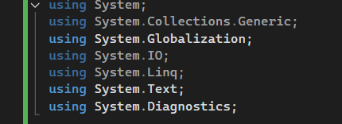
TECHNOLOGIES AND TOOLS USED
C# (LANGUAGE)
.NET
(FRAMEWORK)
LIBRARIES
VISUAL STUDIO

Slide 8

FEATURES AND FUNCTIONALITIES
Admin Log in system
File Handling & Data Persistence
Product & Inventory Management
Arrow-Key Controlled Menu System
Stock Adjustment
Organized Categories System
Receipt & Invoice Generation
Universal Back Navigation
Structured & Modular OOP Design

Slide 9
BENEFITS
Efficient Inventory Managemen
Automated Receipts & Invoices
Fast and Organized Navigation (Arrow-Key Controlled)
Secure Access with Admin Login
Offline & Lightweight

Slide 10
APPLICATIONS
SMALL BOUTIQUE & ONLINE SELLERS
Small Retail Stores
Kiosks and School Businesses

Slide 11
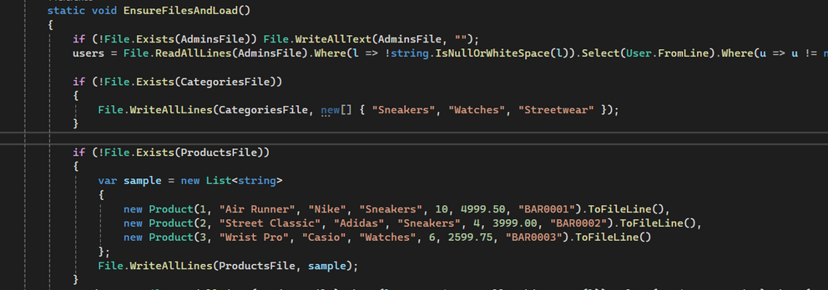

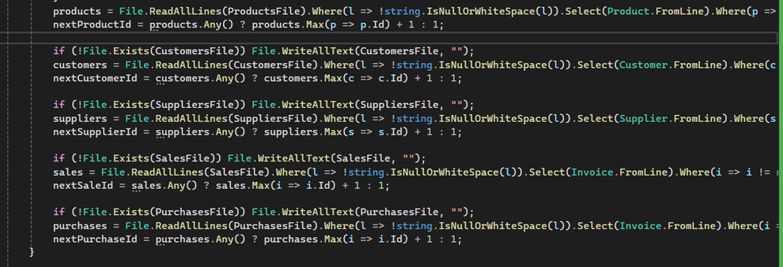
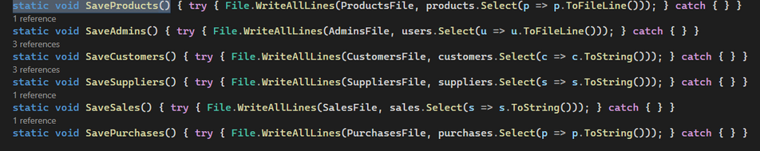
IMPLEMENTING OF FILE HANDLING
FILE CREATION
FILE DELETION
FILE READING
FILE UPDATING

Slide 12
CHALLENGES AND SOLUTIONS
AVOIDING MENU ERRORS WHEN ADDING MANY FEATURES
CHALLENGE:
  EACH NEW FEATURE—SEARCH, DELETE, EDIT, ADJUST STOCK—ADDED MORE
  MENU OPTIONS, INCREASING THE CHANCE OF INPUT ERRORS.
SOLUTION:
  CREATED REUSABLE MENU FUNCTIONS AND CONSISTENT FORMATTING.
  ALSO INTEGRATED A “BACK” OPTION IN EVERY SUBMENU, PREVENTING ERRORS AND IMPROVING NAVIGATION.
MAINTAINING ACCURATE INVENTORY WHILE ALLOWING MULTIPLE OPERATIONS
CHALLENGE:
STOCK NUMBERS COULD EASILY BECOME INCONSISTENT WHEN EDITING, DELETING, ADJUSTING, OR SELLING PRODUCTS.
SOLUTION:
YOU ADDED:
  ARROW-KEY STOCK ADJUSTMENT
  LOW-STOCK DETECTION
  INPUT VALIDATION
  AUTOMATIC SAVING AFTER EVERY CHANGE
THIS ENSURED STOCK LEVELS REMAINED ACCURATE AT ALL TIMES.

Slide 13
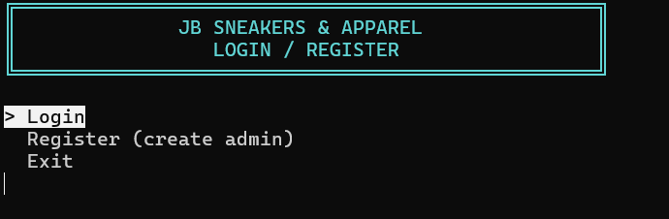
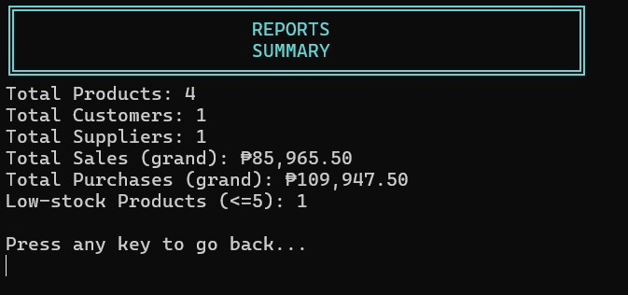
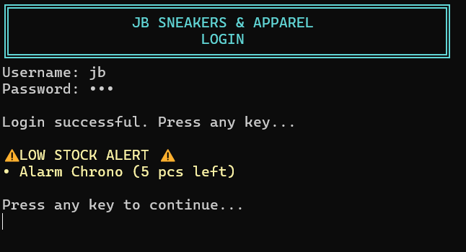
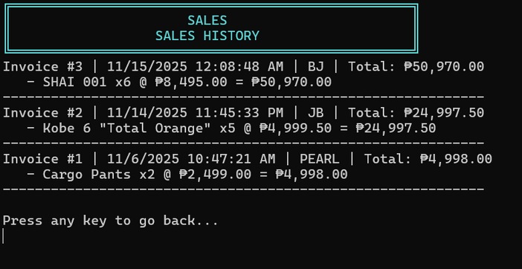
TESTINGS & RESULTS

Slide 14
FUTURE ENHANCEMENTS
GUI
BARCODE SCANNING SUPPORT
MULTIPLE BRACNH SUPPORT
PRODUCT IMAGES

Slide 15
CONCLUSION
The JB SNEAKERS & APPAREL POS System successfully achieved its goal of providing a functional console-based inventory and sales management solution. Through features such as admin login, product management, dynamic categories, arrow-key navigation, and automatic invoice and receipt generation, the system provides reliable support for small retail operations.

Slide 16
CONCLUSION
The project demonstrated effective use of C#, object-oriented programming, and file handling to simulate real POS workflows. Despite being a console application, it delivers an organized and user-friendly experience. Overall, the development of this system strengthened skills in system design, data management, and creating practical business solutions using programming.

Slide 17


THANK
YOU

